Slide 1
Ambulance Intake

Slide 2
Why?
Why-
To improve patient flow that enters via Ambulance
Reduce chaos in the department
How
Standardized approach to offloading patients arriving via ambulance.
Assess patients that come in via ambulance prior to placing them in the Waiting Room.
Reduce foot traffic within the department
What
Developing a standardized process for patients that arrive via Ambulance.

Slide 3
Key Takeaways
Able to offload EMS patients faster
Improvement of door to EKG times
Reduce Traffic in the department
Reduce tension between EMS and ED staff
Reduce bottlenecking of Patients in Triage.
Flow will be able to assign a Pod spot to the Patient in the most need of the spot and not just the patient coming in by Ambulance.

Slide 4
Key Players
Nursing
Registration
ED Tech/ Paramedic
Transport
Physician Group

Slide 5
Materials
Radio
Computer on Wheels (WOW)
Vital Machine
EKG Machine
IV/ Lab drawing materials
Stretchers/ Wheelchairs/ Chairs
Portable Monitors
Linen

Slide 6
Patient Exclusion List
Decompensating patients
Cardiac Arrest
Trauma
Stroke
STEMI
Violent/ Code Safety
Transfers- due to EMTALA
Pediatrics- Pedi will continue with their current process and at times will need to send EMS patients out to triage. There is a plan to discuss the potential of a similar process at the 30 day re-eval.

Slide 7
Staffing
With Ambulance Intake there will be a new staffing grid that will give the Flow RN guidance on where to place staff based on staffing numbers
Based on the new staffing grid, in high census times there will be two RNs assigned to this area
RNs that have been Triage trained are qualified to work in this area. Please refrain from assigning Traveler RNs due to their lack of knowledge of Hospital Policy and Procedure.

Slide 8
Process Outline
EMS Calls
Patient Arrives
Registration
Flow Desk
Offload
Handoff & Triage
Waiting Room vs. Pod Spot
Vital Signs & Orders

Slide 9
Patient Arrives
EMS patches in Patient complaint in through the CMED radio
Flow RN takes note of the call
Patient arrives via Ambulance

Slide 10
Registration
Patient is brought to Registration desk for initiation of the registration process and the generation of the Patient's chart
Registration places patient band on Patient and prints a set of patient registrations labels.

Slide 11
Flow Desk
After registration, EMS will bring the Patient to the Flow desk.
The Flow RN decides placement in the department for the patient. Flow RNs should be following the pull to full method with the allowance to keep open a "crash bed."
If there is no spot available, the Patient will proceed to Ambulance Intake.

Slide 12
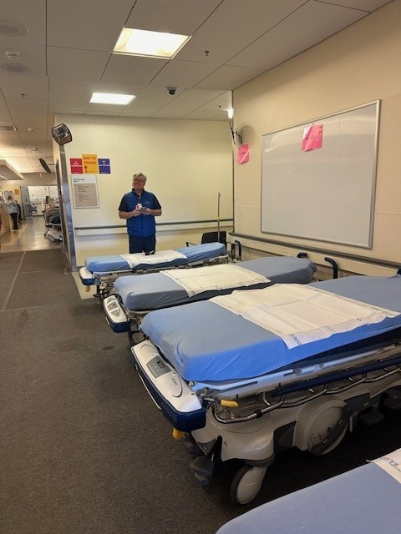
Offload
Ambulance Intake RN Greets EMS personnel.
Together RN and EMS decide if patient can be offloaded into a chair/ wheelchair or needs stretcher
*please keep in mind there is limited space for stretchers
Patient is offloaded

Slide 13
Patient Handoff & Triage
EMS gives report to Ambulance Intake RN.
EMS leaves via the CT hallway to the "Bright Hallway" and out to the Ambulance Bay.
*Please encourage EMS to exit this way to help prevent any congestion.
RN enters in a FULL triage.
RN orders appropriate Triage orders based on the approved Standing Order list.

Slide 14
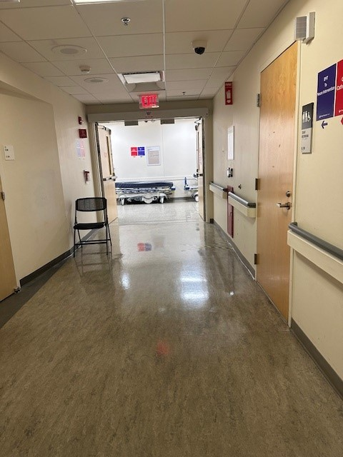
EMS Exit
CT Hallway
"Bright" Hallway

Slide 15
Vital Signs & Triage Orders
Tech obtains vital signs on the Patient while RN is receiving report.
RN communicates to ED Tech of orders placed.
ED Tech completes orders.
*EKGS will go to the North Pod Attending to be reviewed.

Slide 16
Waiting Room vs Ambulance Intake
Once full triage is done, and all orders have been complete there will be a decision made by the RN if the patient is stable to transferred to the waiting room or if the patient is unstable and will need to stay in Ambulance Intake to wait for pod spot.
Stable patients will be escorted to the waiting by transport. RNs will need to communicate to transport to which patient is appropriate.
Patients will be brought down the CT hallway through the "Bright Hallway" to the Noonan Concourse and then enter the Waiting Room.
Being "deemed safe" is the judgement of the RN. The decision to move a patient to the waiting room can occur any time after the triage and orders are completed.
Patients are that deemed unstable to be in the Waiting Room will remain in Ambulance Intake. The RN will communicate with Flow the need for a Pod spot.

Slide 17
Script
We encourage the use of this script for those going to Waiting room...
"
This allows for all of us have the same message to the patient.

Slide 18
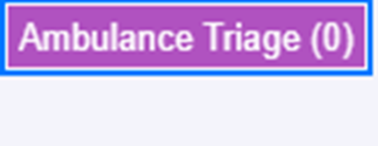
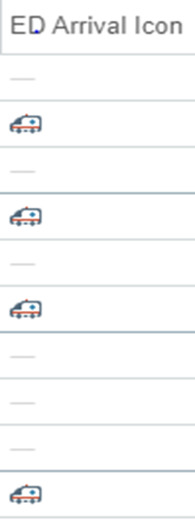
Identifying Patients
Patients in Ambulance Intake
Patients in the
Waiting Room
Patients in Ambulance Intake will be placed in the Ambulance Triage tab.
Patients in the Waiting Room from Ambulance intake will be identifiable by the ambulance Icon

Slide 19
Troubleshooting and then some....
Please escalate to flow when …
-The area is becoming congested
-If a patient in Ambulance Intake is decompensating
- If there is a need for additional staff or equipment
Do your best to keep this area moving to avoid any grid lock.
All MD escalations will go to the North Pod Attending
If a patient decompensates while in Ambulance Triage, the patient will be pulled into a Trauma Bay Room unless Flow is able to make an appropriate space for the patient in the Pod.
Due to the size of this area, patient safety and privacy, limit visitors that are not deemed "Caregivers." Please remember visitors can always visit once the Patient is given a spot in the department.
North Admin halls 1-5 will no longer exists.

Slide 20
Go Live- Monday January 22, 2023

Slide 21
Follow- up
There will be a 30 day and 90 day re-eval of this process. All staff will be invited to help give feedback.
There will also be a binder available at the Flow desk to write down suggestions and feedback in real time.

